Slide 1
estimation vs prediction
Unit 1.4: Ch 4.9 Notes

Slide 2
Using the model for Prediction and estimation
Ch 4.9

Slide 3
The goal for multiple linear regression is to
predict the response for a particular subject, given a set of predictors
estimate the average response for a particular group of subjects who all have the same set of predictors.

Slide 4

Example
Each observation (subject) in your data represents one quarterback in one season in the NFL. We have recorded their yards per game, number of touchdowns, and number of interceptions during the season and would like to build a model to predict a player’s salary.
PREDICTION: One particular player has 320 yards per game, 34 touch downs, and 16 interceptions. What is that player’s predicted salary?
ESTIMATION: There are several players who have 295 yards per game, 17 touchdowns, and 12 interceptions. What is the estimate of the average salary for those players?

Slide 5

Example
Each observation (subject) in your data represents the one month of sales from your company. You have recorded the advertising dollars, number of clients, and the quarter. You would like to use those variables to build a model to predict the sales for the month.
PREDICTION: For the next month, you anticipate spending $1000 on advertising, having 4 clients, and it is the quarter 1. What do you predict that month’s sales to be?
ESTIMATION: Several months have an anticipated budget of $1000 for advertising, 4 clients, and quarter 1. What are the estimated average sales for those months?

Slide 6
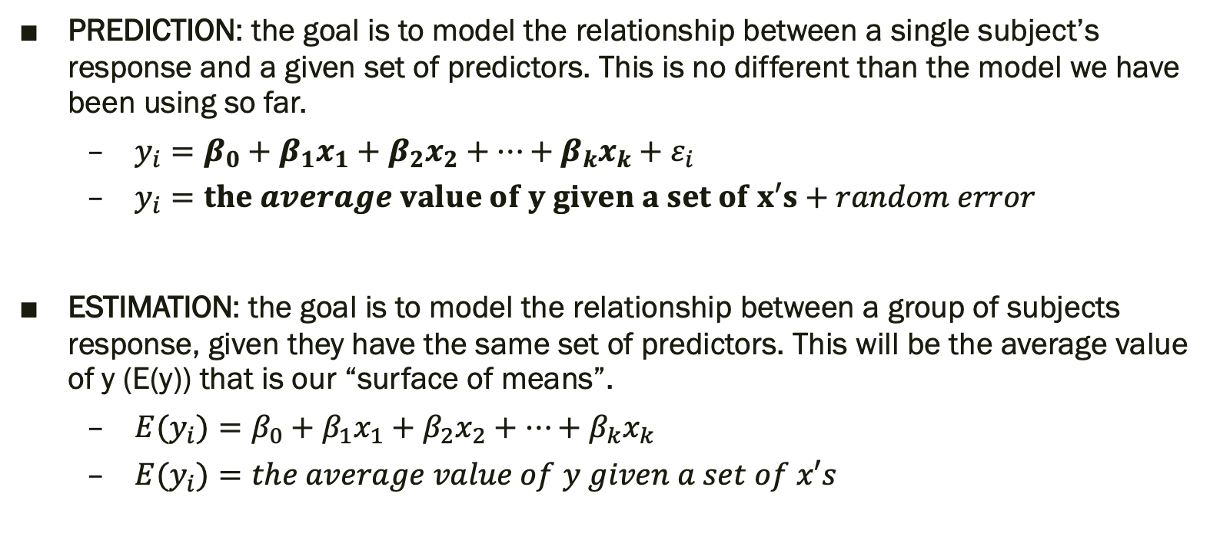
Writing the model: Before you write you model, you should decide: is your goal PREDICTION or ESTIMATION?
PREDICTION: the goal is to model the relationship between a single subject’s response and a given set of predictors. This is no different than the model we have been using so far.
$y_{i}=β_{0}+β_{1}x_{1}+β_{2}x_{2}+…+β_{k}x_{k}+ε_{i}$
$y_{i}=the average value of y given a set of x′s+random error$
ESTIMATION: the goal is to model the relationship between a group of subjects response, given they have the same set of predictors. This will be the average value of y (E(y)) that is our “surface of means”.
$E(y_{i})=β_{0}+β_{1}x_{1}+β_{2}x_{2}+…+β_{k}x_{k}$
${E(y}_{i})=the average value of y given a set of x′s$

Slide 7
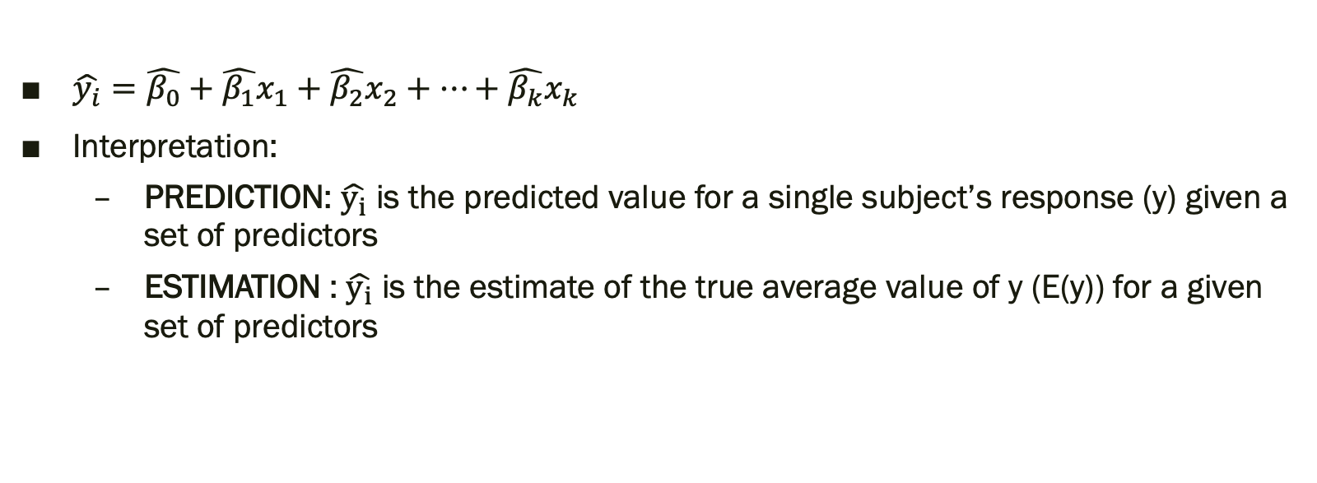
Writing the prediction equation: Whether you intend to use your model for prediction OR estimation, you end up with the same prediction equation.
$\hat{y_{i}}=\hat{β_{0}}+\hat{β_{1}}x_{1}+\hat{β_{2}}x_{2}+…+\hat{β_{k}}x_{k}$
Interpretation:
PREDICTION: $\hat{y_{i}}$ is the predicted value for a single subject’s response (y) given a set of predictors
ESTIMATION : $\hat{y_{i}}$ is the estimate of the true average value of y (E(y)) for a given set of predictors

Slide 8
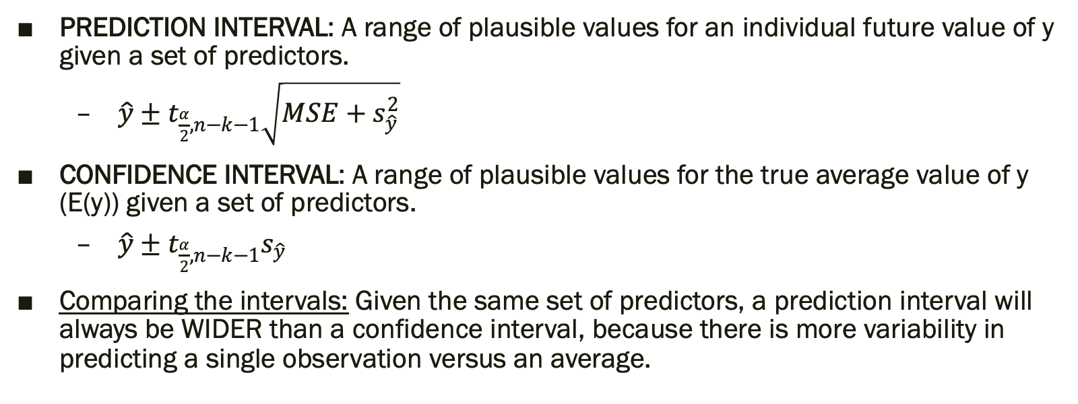
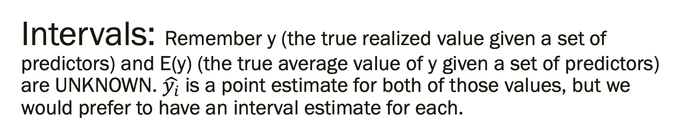
Intervals: Remember y (the true realized value given a set of predictors) and E(y) (the true average value of y given a set of predictors) are UNKNOWN. $\hat{y_{i}}$ is a point estimate for both of those values, but we would prefer to have an interval estimate for each.
PREDICTION INTERVAL: A range of plausible values for an individual future value of y given a set of predictors.
$\hat{y}±t_{\frac{α}{2},n−k−1}\sqrt{MSE+s_{\hat{y}}^{2}}$
CONFIDENCE INTERVAL: A range of plausible values for the true average value of y (E(y)) given a set of predictors.
$\hat{y}±t_{\frac{α}{2},n−k−1}s_{\hat{y}}$
Comparing the intervals: Given the same set of predictors, a prediction interval will always be WIDER than a confidence interval, because there is more variability in predicting a single observation versus an average.

Slide 9
Example
Earnings of Mexican Street Vendors

Slide 10
Step 1: Background & Data
Detailed interviews were conducted with over 1,000 street vendors in the city of Puebla, Mexico, in order to study the factors influencing vendors’ incomes. Vendors were defined as individuals working in the street and included vendors with carts and stands on wheels and excluded beggars, drug dealers, and prostitutes. The researchers collected data on gender, age, hours worked per day, annual earnings, and education level. We have a sample of 15 vendors from this list and we will examine the following:
Annual Earnings (response, y)
Age (explanatory, x₁)
Hours Worked Per Day (Explanatory, x₂)

Slide 11
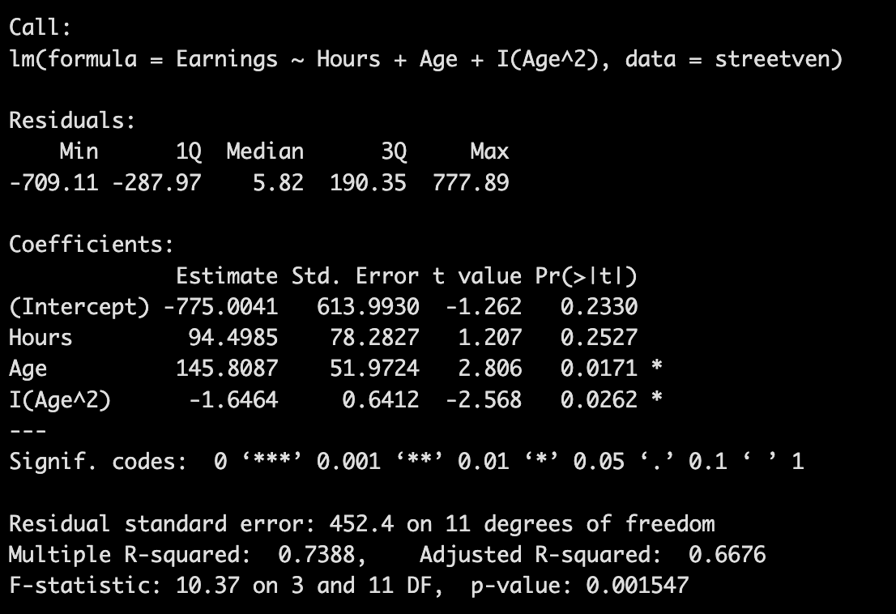
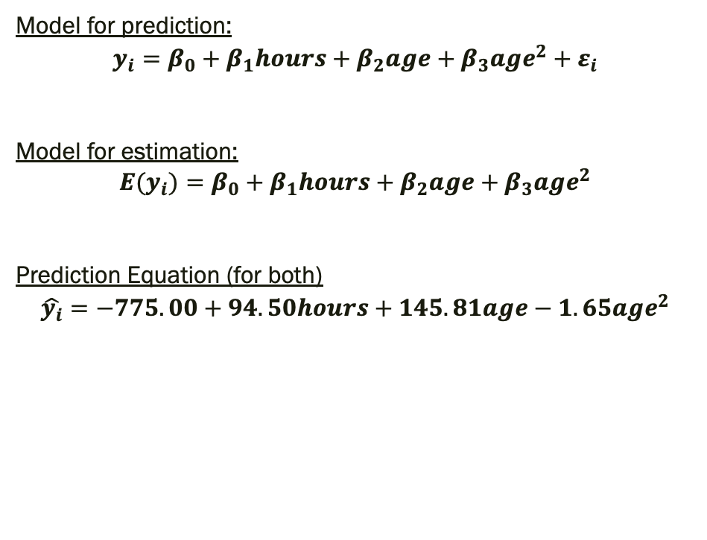
Step 2-4: Reminder of model fit
Model for prediction:
$$y_{i}=β_{0}+β_{1}hours+β_{2}age+β_{3}age^{2}+ε_{i}$$
Model for estimation:
$$E(y_{i})=β_{0}+β_{1}hours+β_{2}age+β_{3}age^{2}$$
Prediction Equation (for both)
$$\hat{y_{i}}=−775.00+94.50hours+145.81age−1.65age^{2}$$

Slide 12
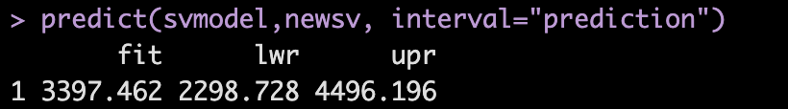
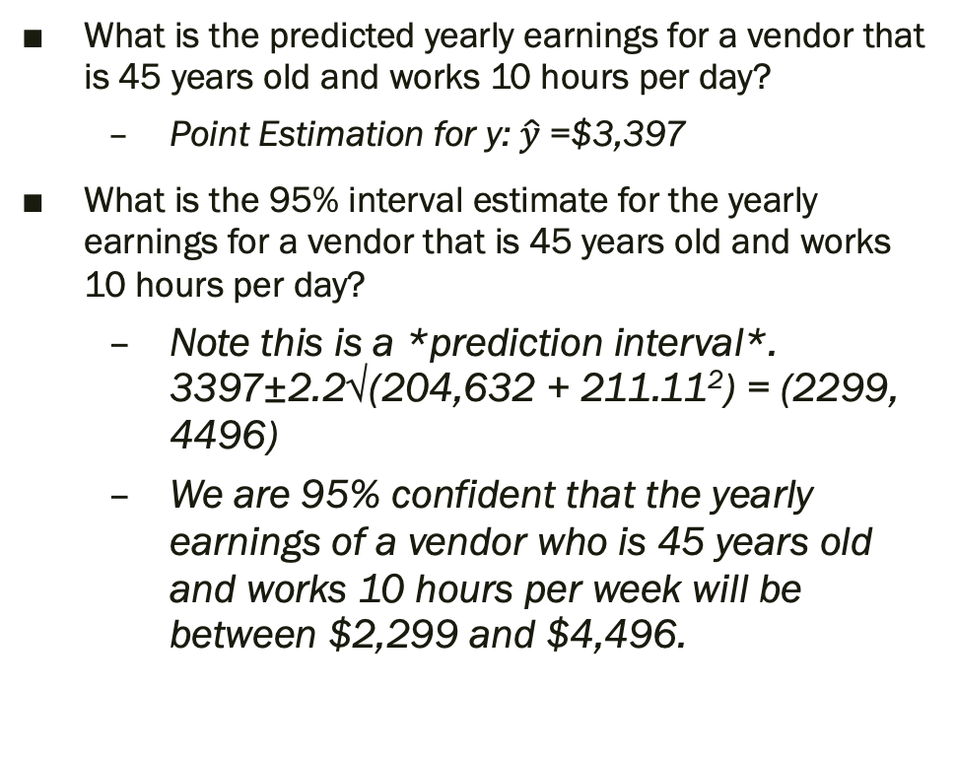
Step 7: Use the model for prediction
What is the predicted yearly earnings for a vendor that is 45 years old and works 10 hours per day?
Point Estimation for y: $\hat{y}$=$3,397
What is the 95% interval estimate for the yearly earnings for a vendor that is 45 years old and works 10 hours per day?
Note this is a *prediction interval*. 3397±2.2√(204,632 + 211.11²) = (2299, 4496)
We are 95% confident that the yearly earnings of a vendor who is 45 years old and works 10 hours per week will be between $2,299 and $4,496.

Slide 13
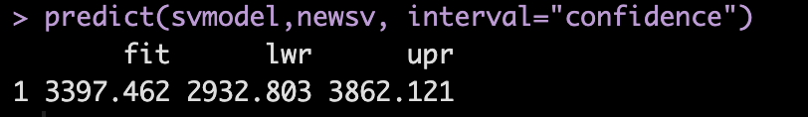
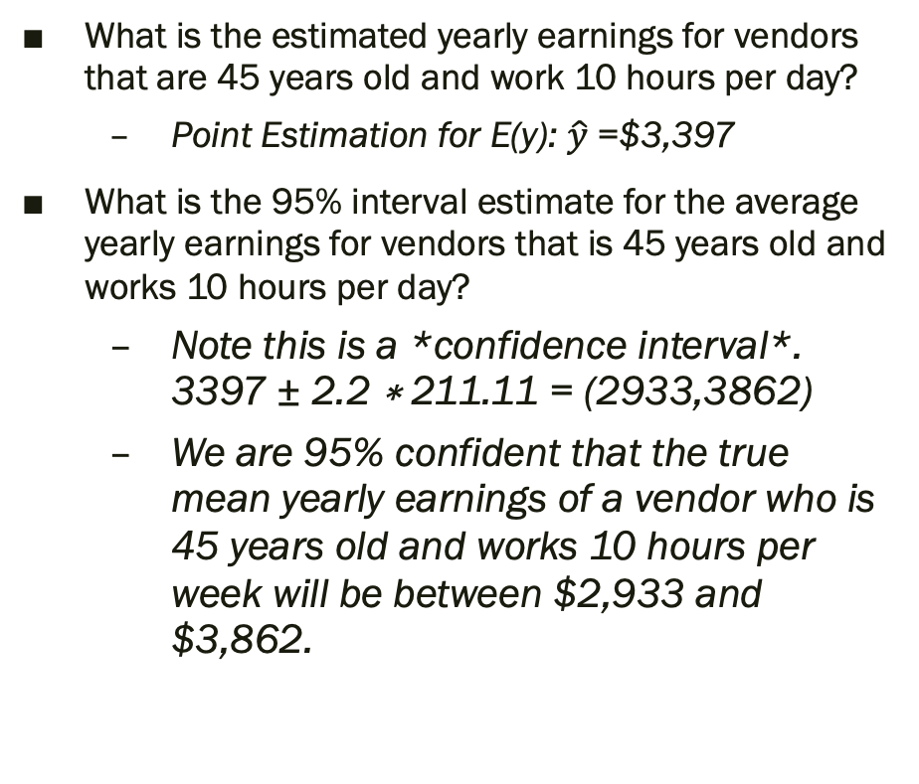
Step 7: Use the model for estimation
What is the estimated yearly earnings for vendors that are 45 years old and work 10 hours per day?
Point Estimation for E(y): $\hat{y}$=$3,397
What is the 95% interval estimate for the average yearly earnings for vendors that is 45 years old and works 10 hours per day?
Note this is a *confidence interval*. 3397 ± 2.2 ∗ 211.11 = (2933,3862)
We are 95% confident that the true mean yearly earnings of a vendor who is 45 years old and works 10 hours per week will be between $2,933 and $3,862.

